Slide 1
Fitness Studio Management System
Jyothirlatha Perla 700759284
Sai Smruthi Siddemsetty 700754105
Naresh Babu Gunji 700764991
Goverarram Soumya 700756001

Slide 2
Database Description
The Fitness Studio Management System is designed to offer an integrated solution for efficiently managing users, memberships, class schedules, and personalized diet plans. It automates core processes to ensure seamless coordination among admins, trainers, and users. The system caters to multiple roles—admins, trainers, and regular users, each with unique permissions and features, providing a streamlined experience for booking classes, tracking progress, and adhering to diet plans.

Slide 3
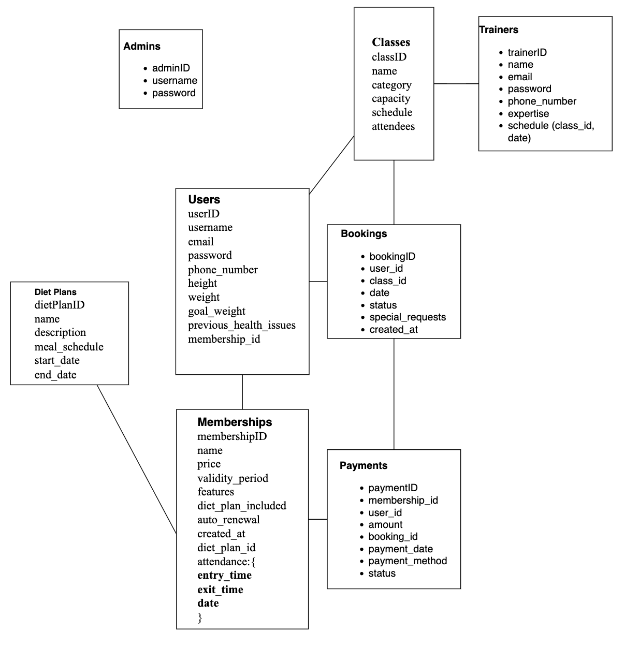
Database Schema

Slide 4
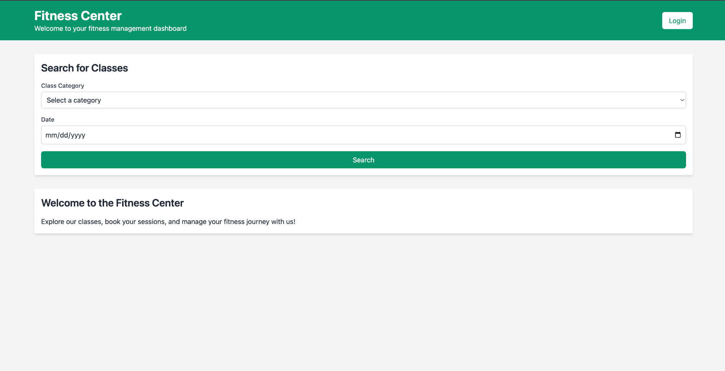
Home Page

Slide 5
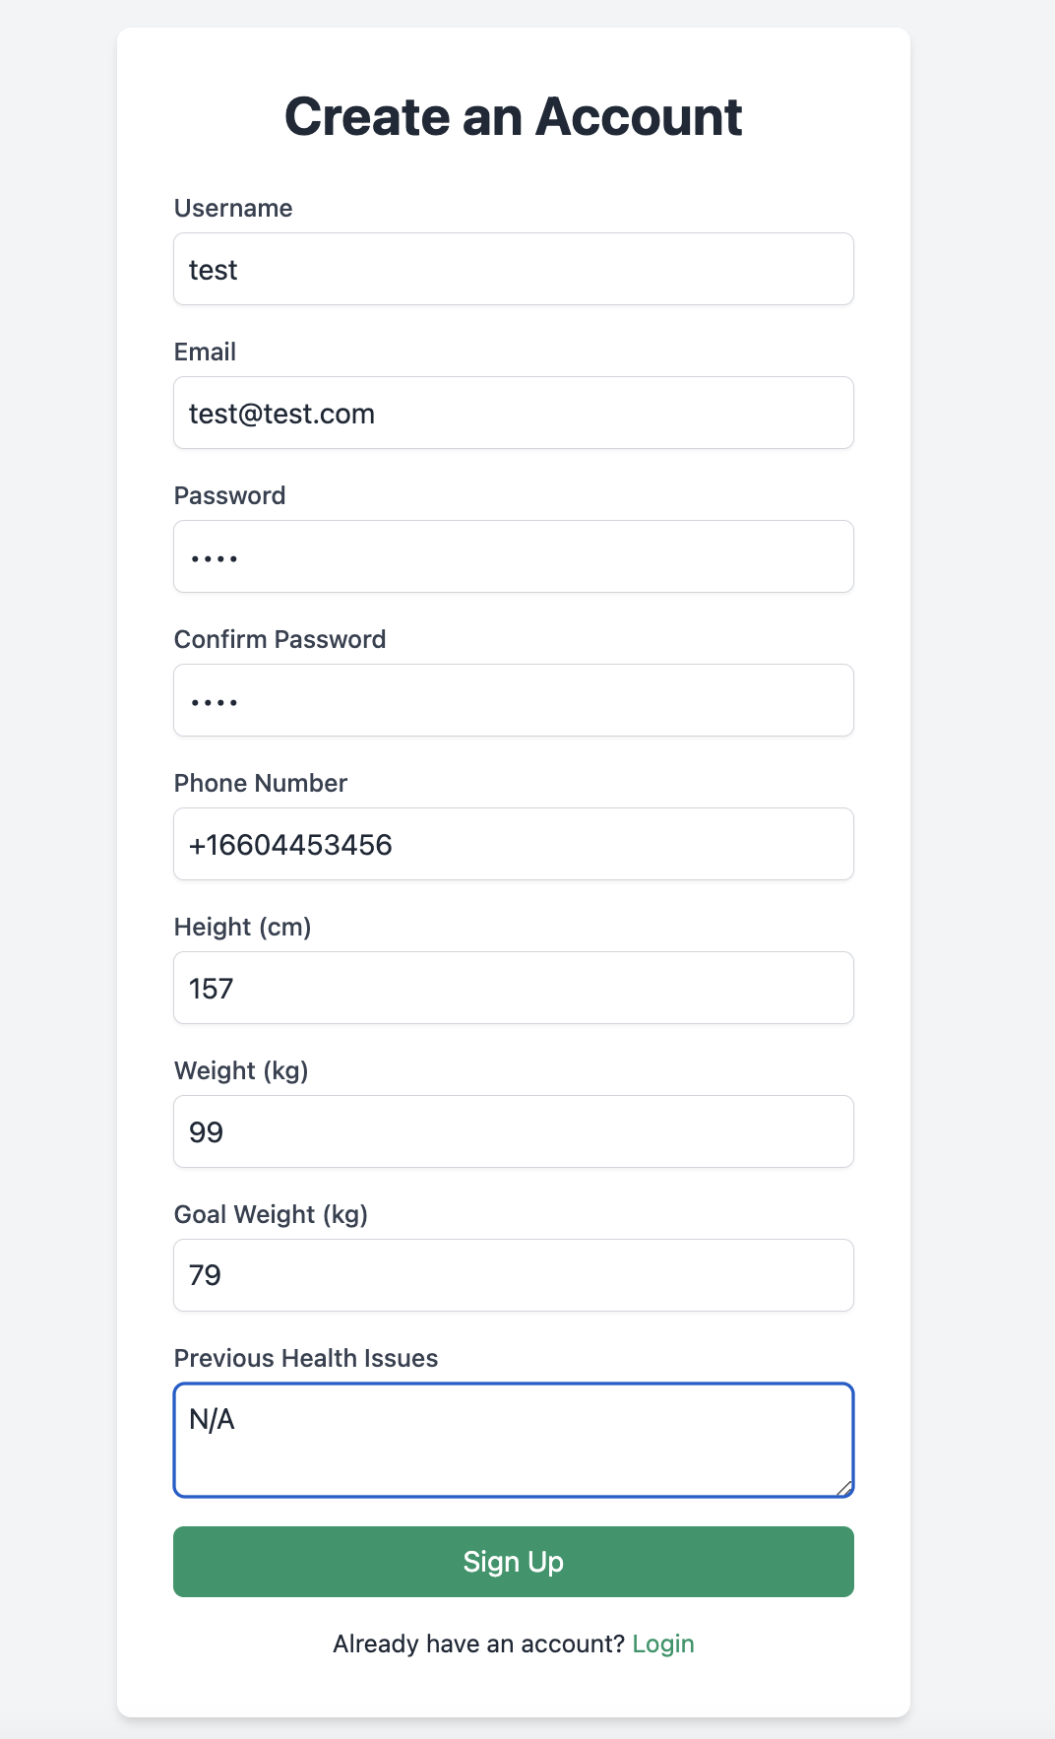
User Registration

Slide 6
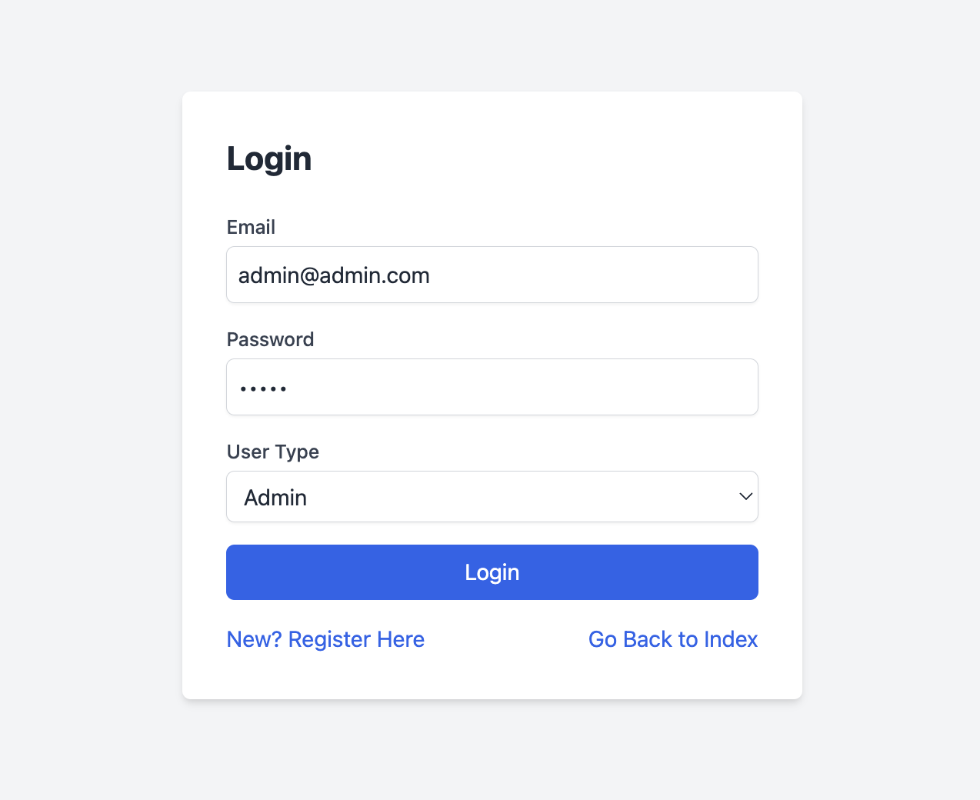
Admin Login

Slide 7
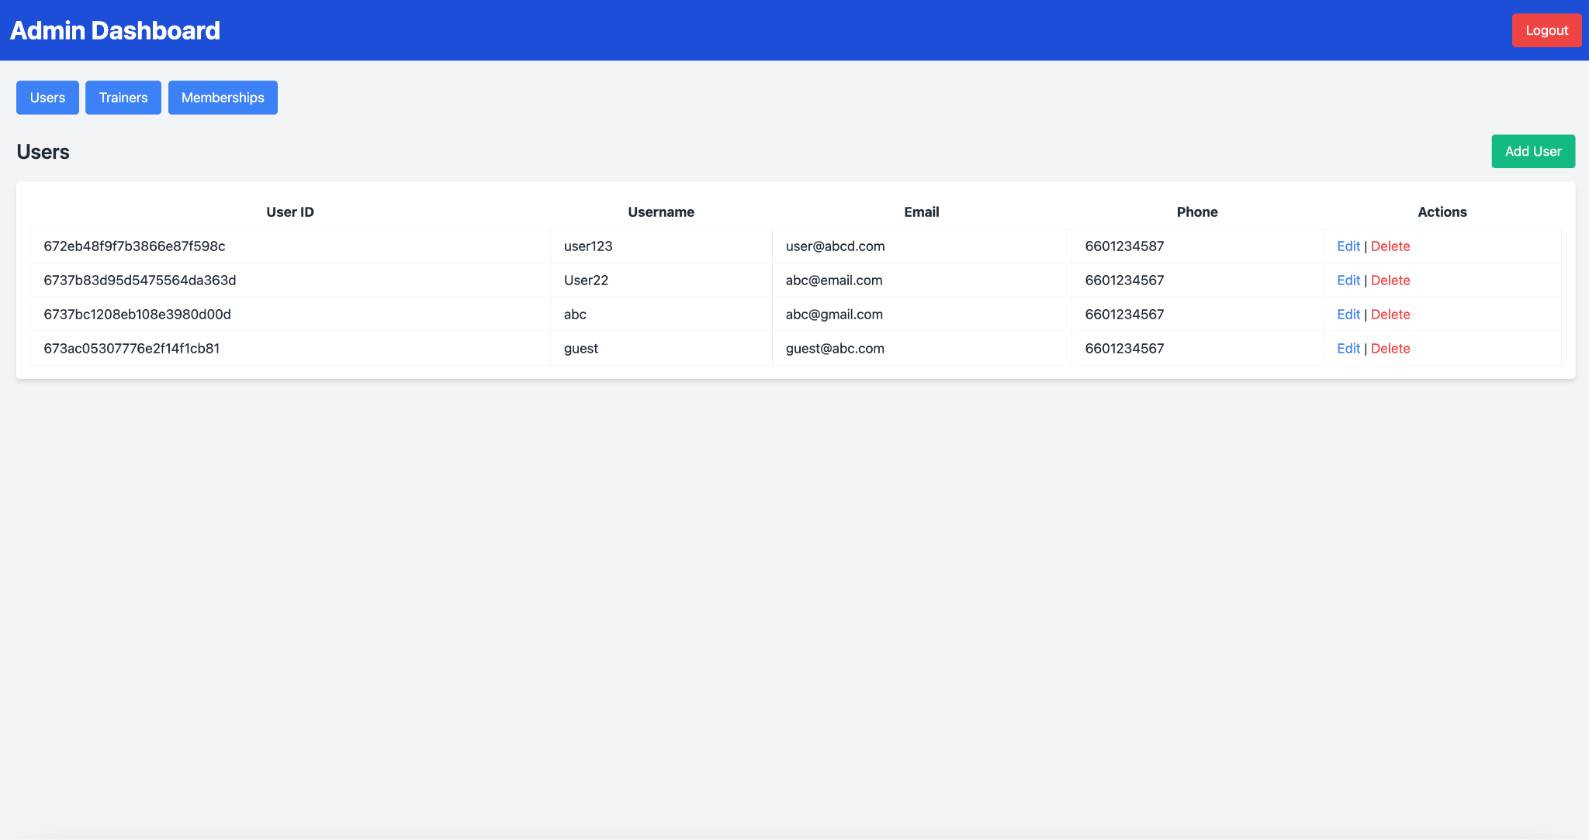
Admin Dashboard

Slide 8
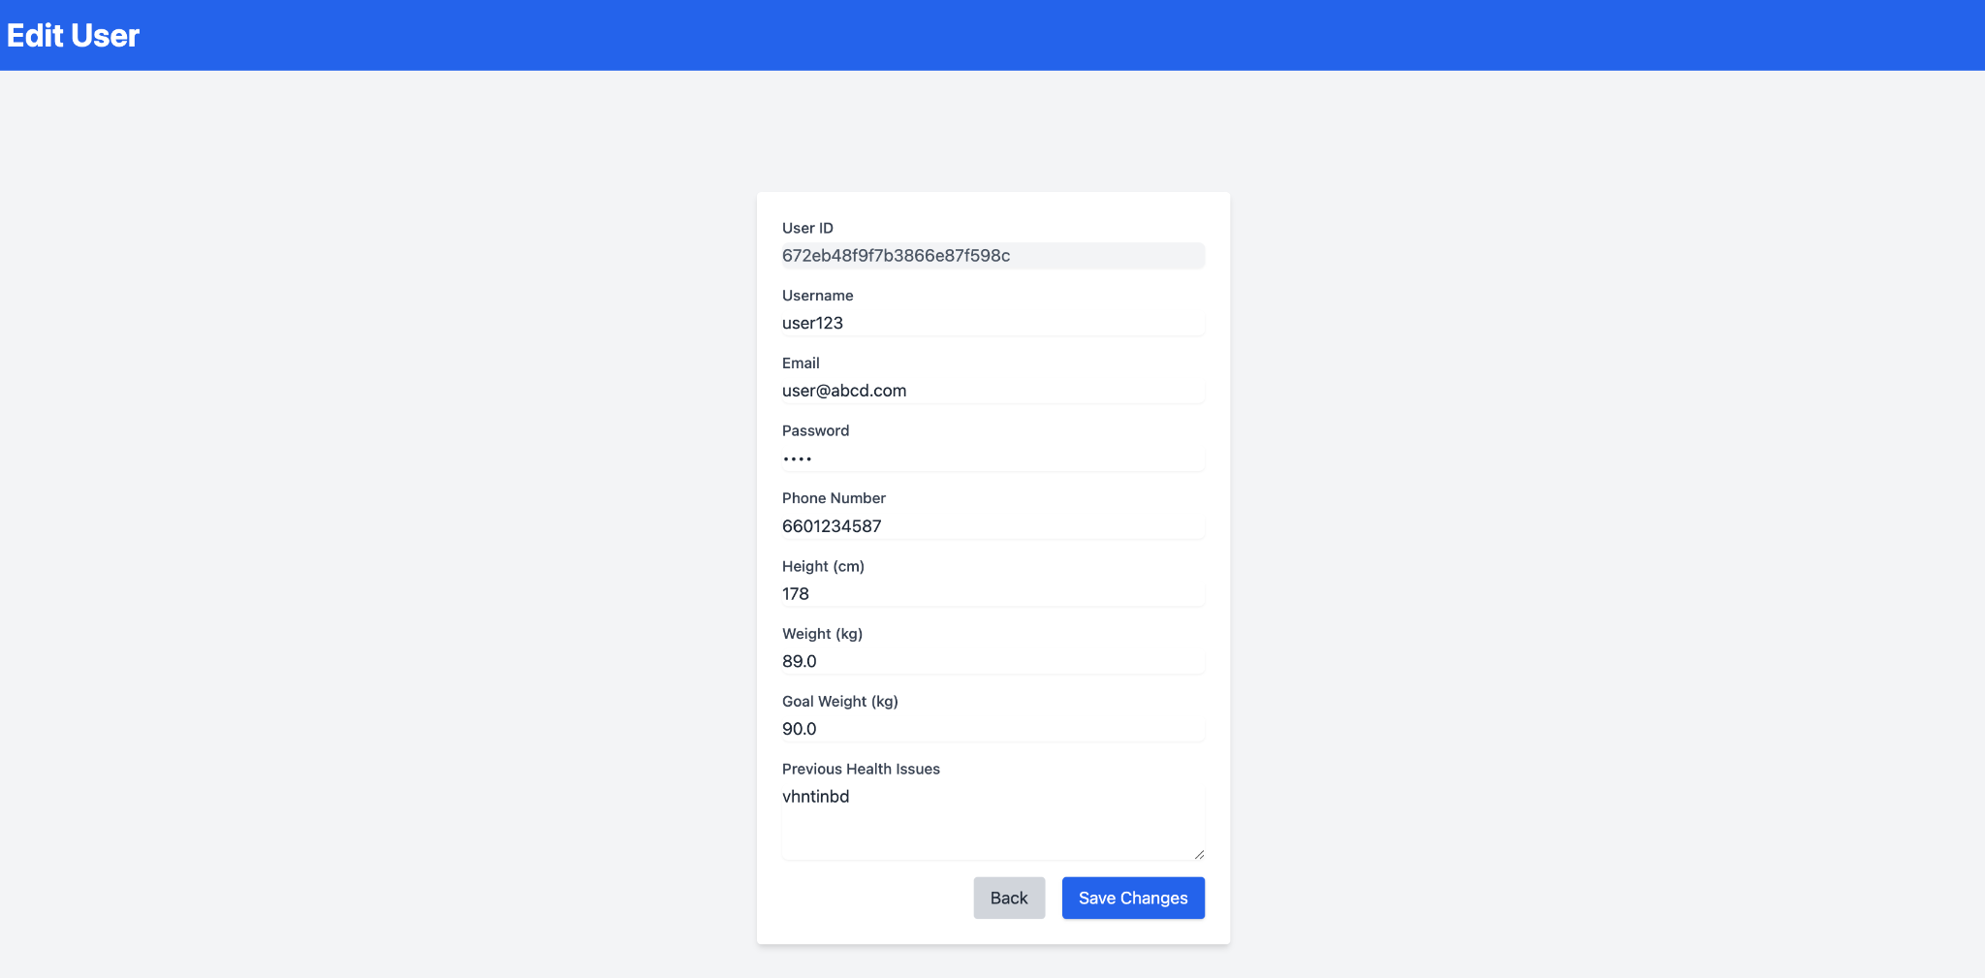
Edit User

Slide 9
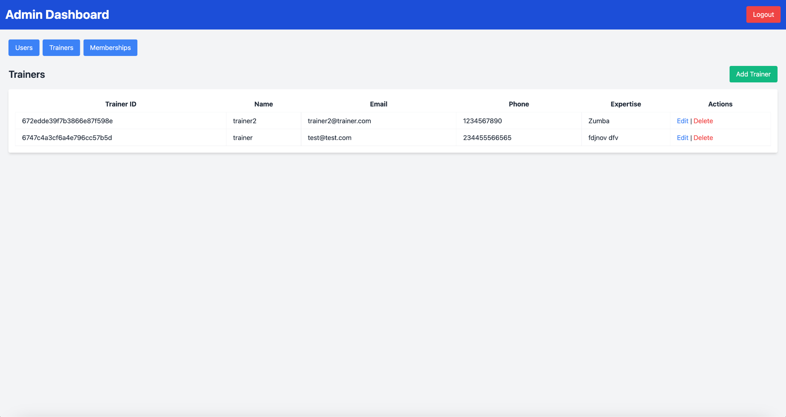
Admin Dashboard (Trainer List)

Slide 10
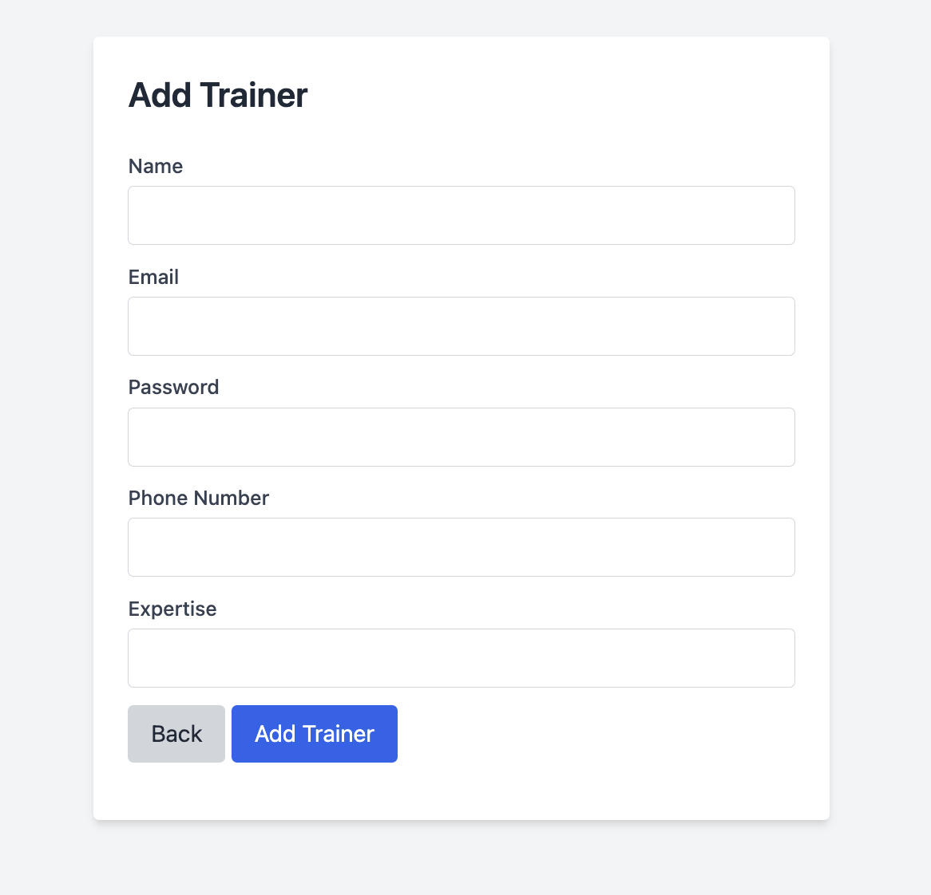
Add Trainer

Slide 11
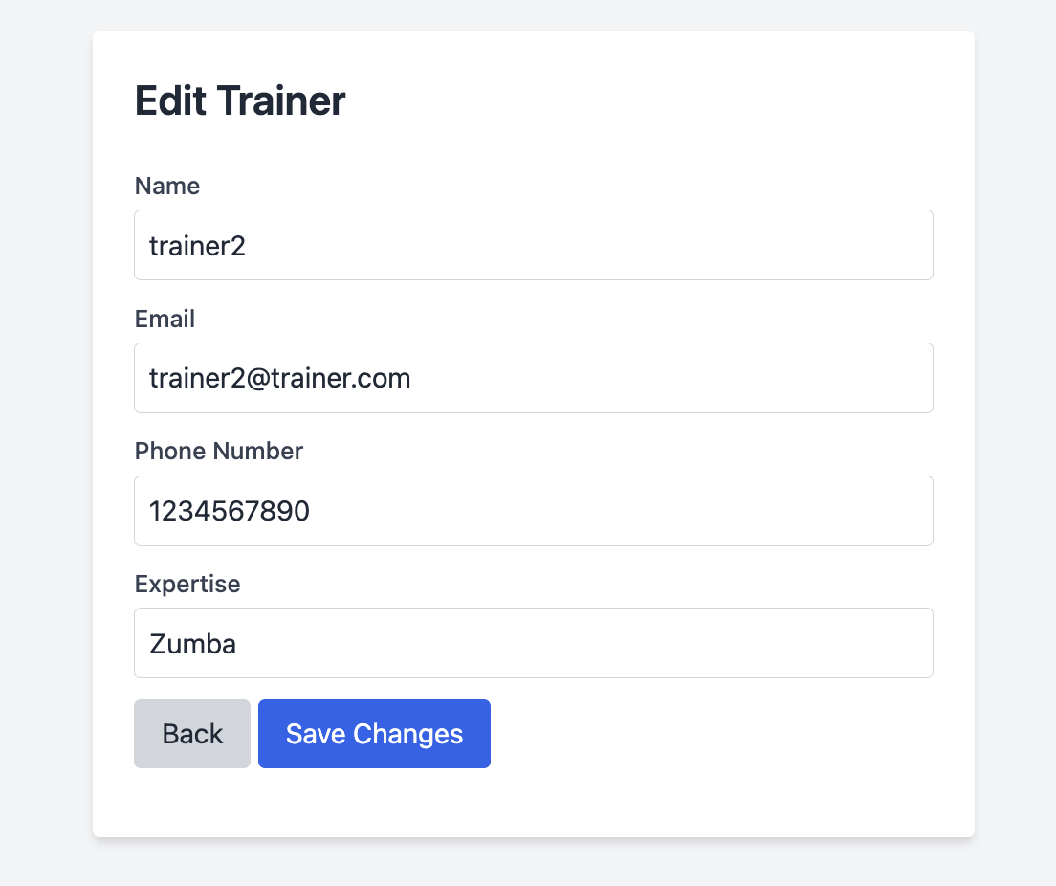
Edit Trainer

Slide 12
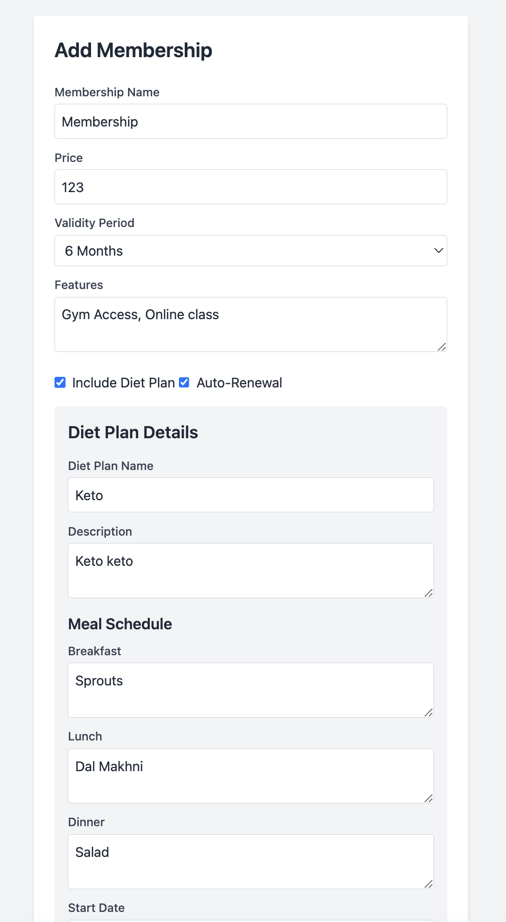
Add Membership

Slide 13
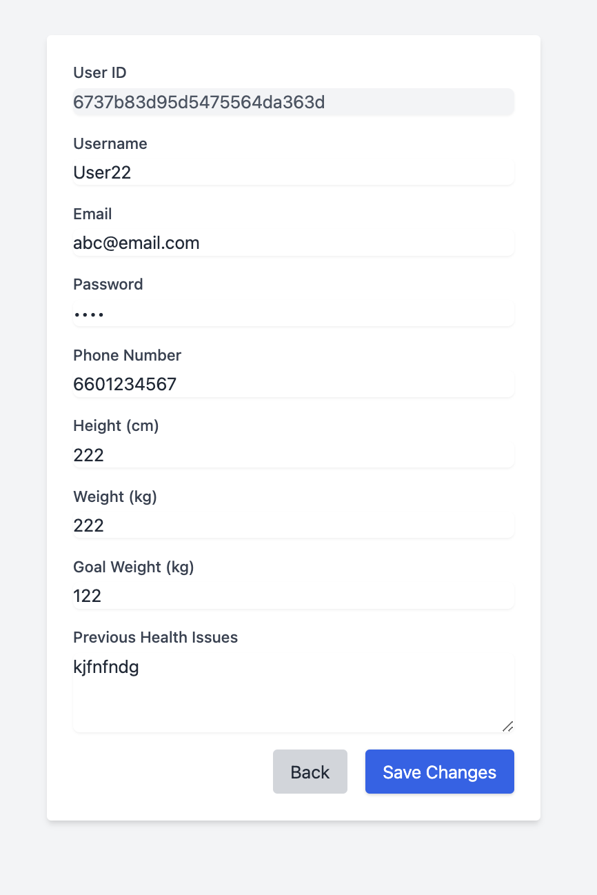
Edit Membership

Slide 14
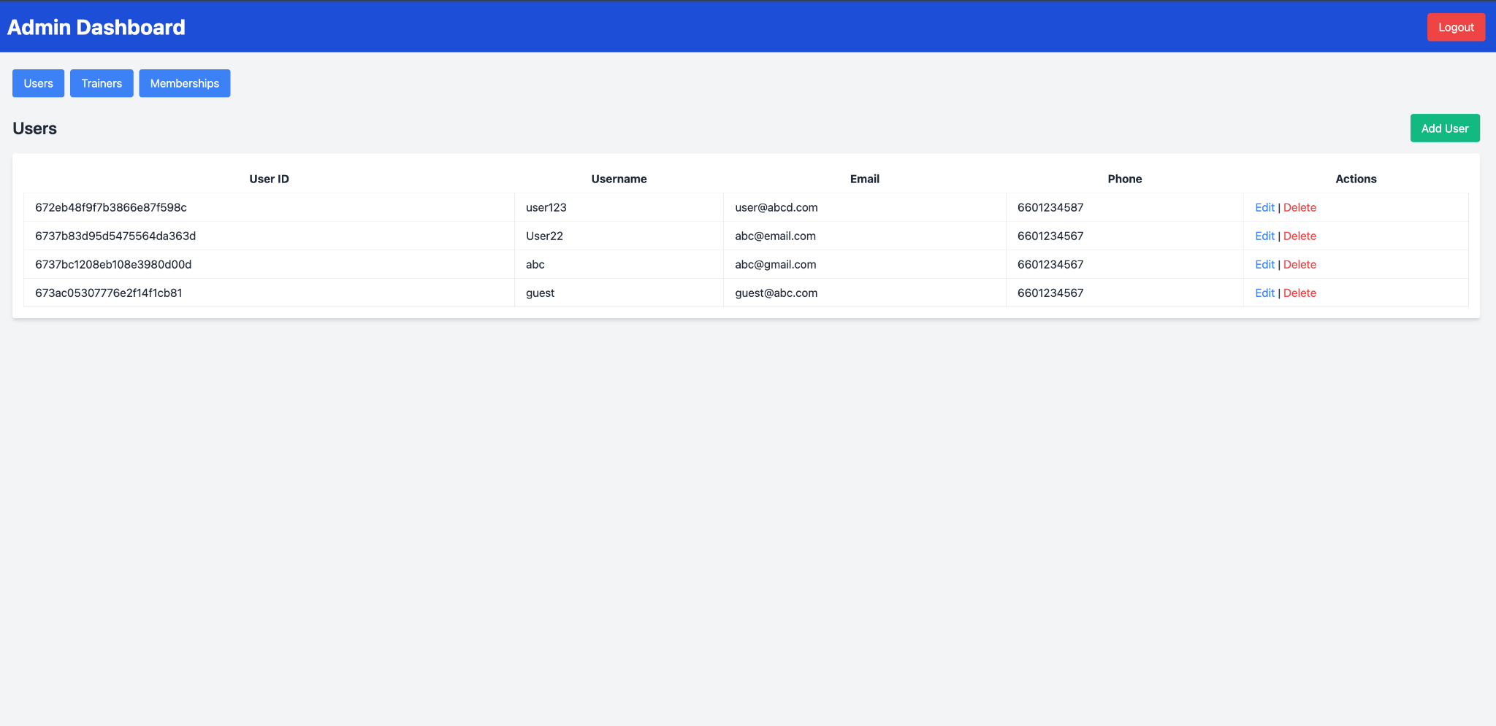
Admin Dashboard (Membership)

Slide 15
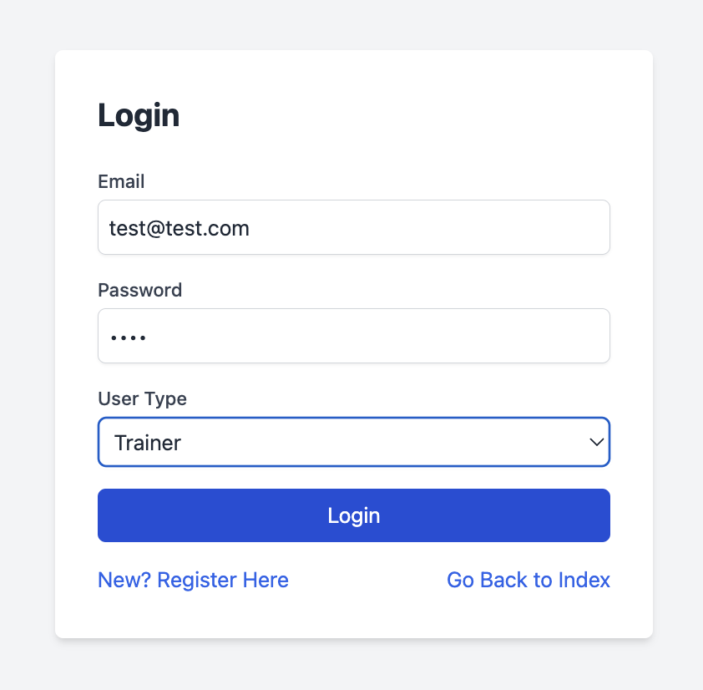
Trainer Login

Slide 16
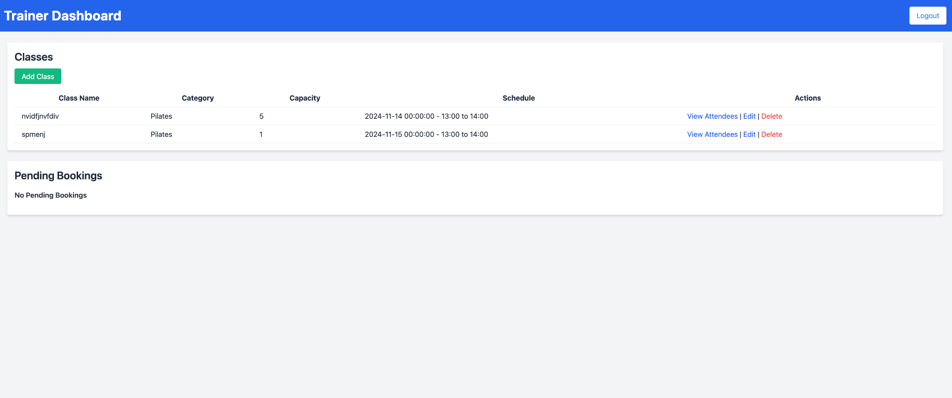
Trainer Dashboard

Slide 17
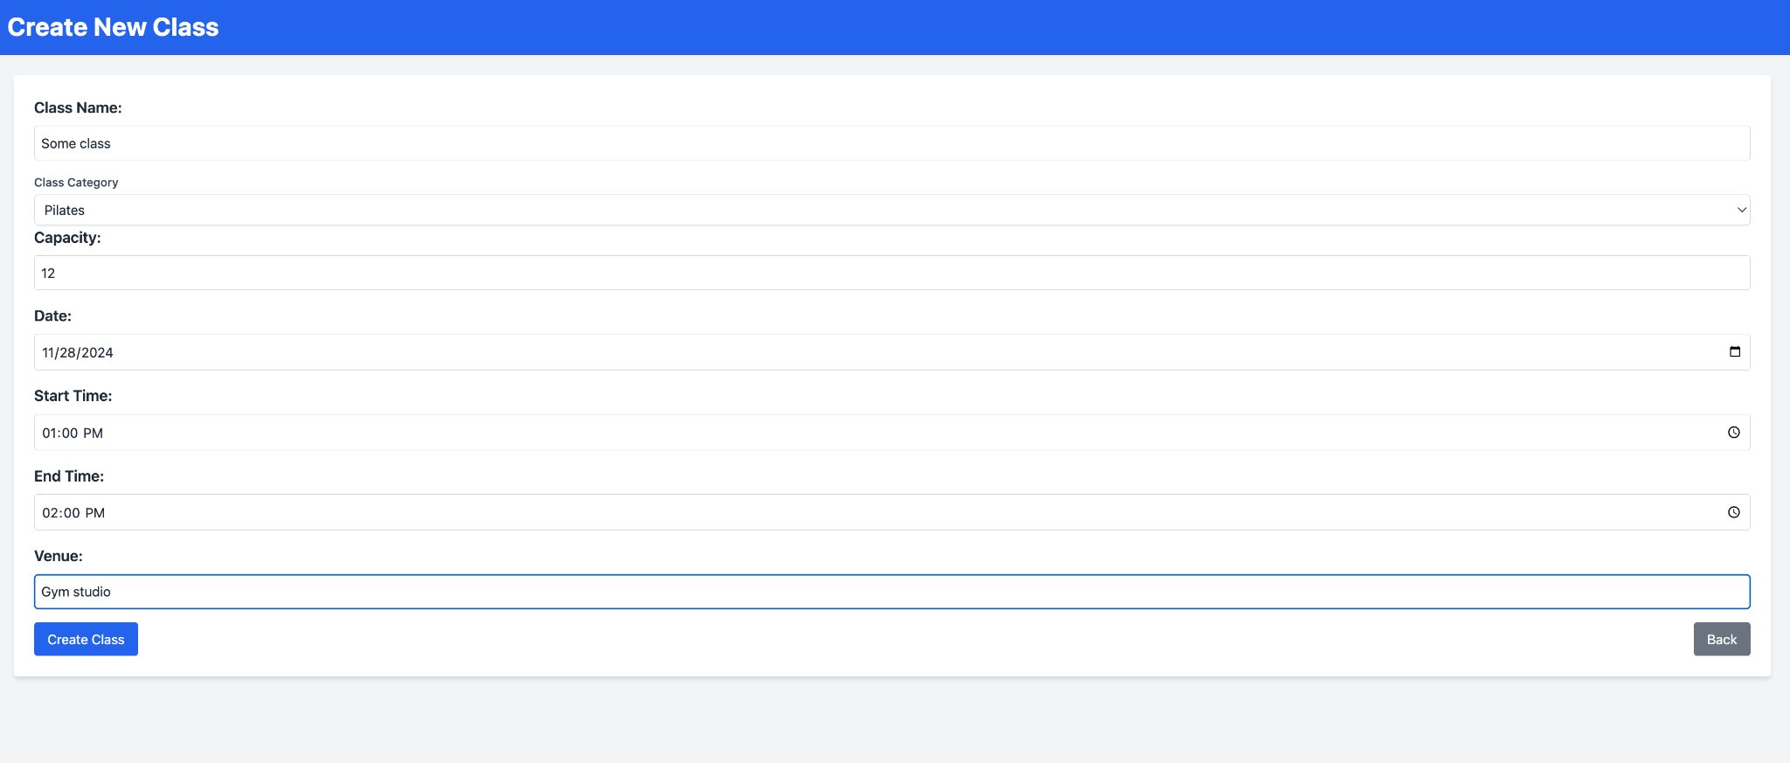
Create Class

Slide 18
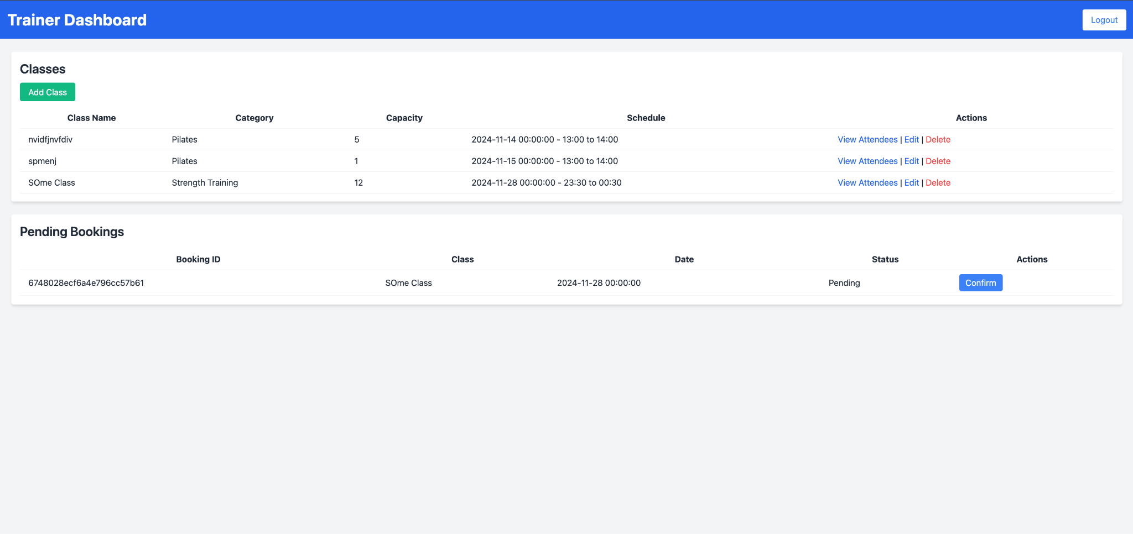
Bookings

Slide 19
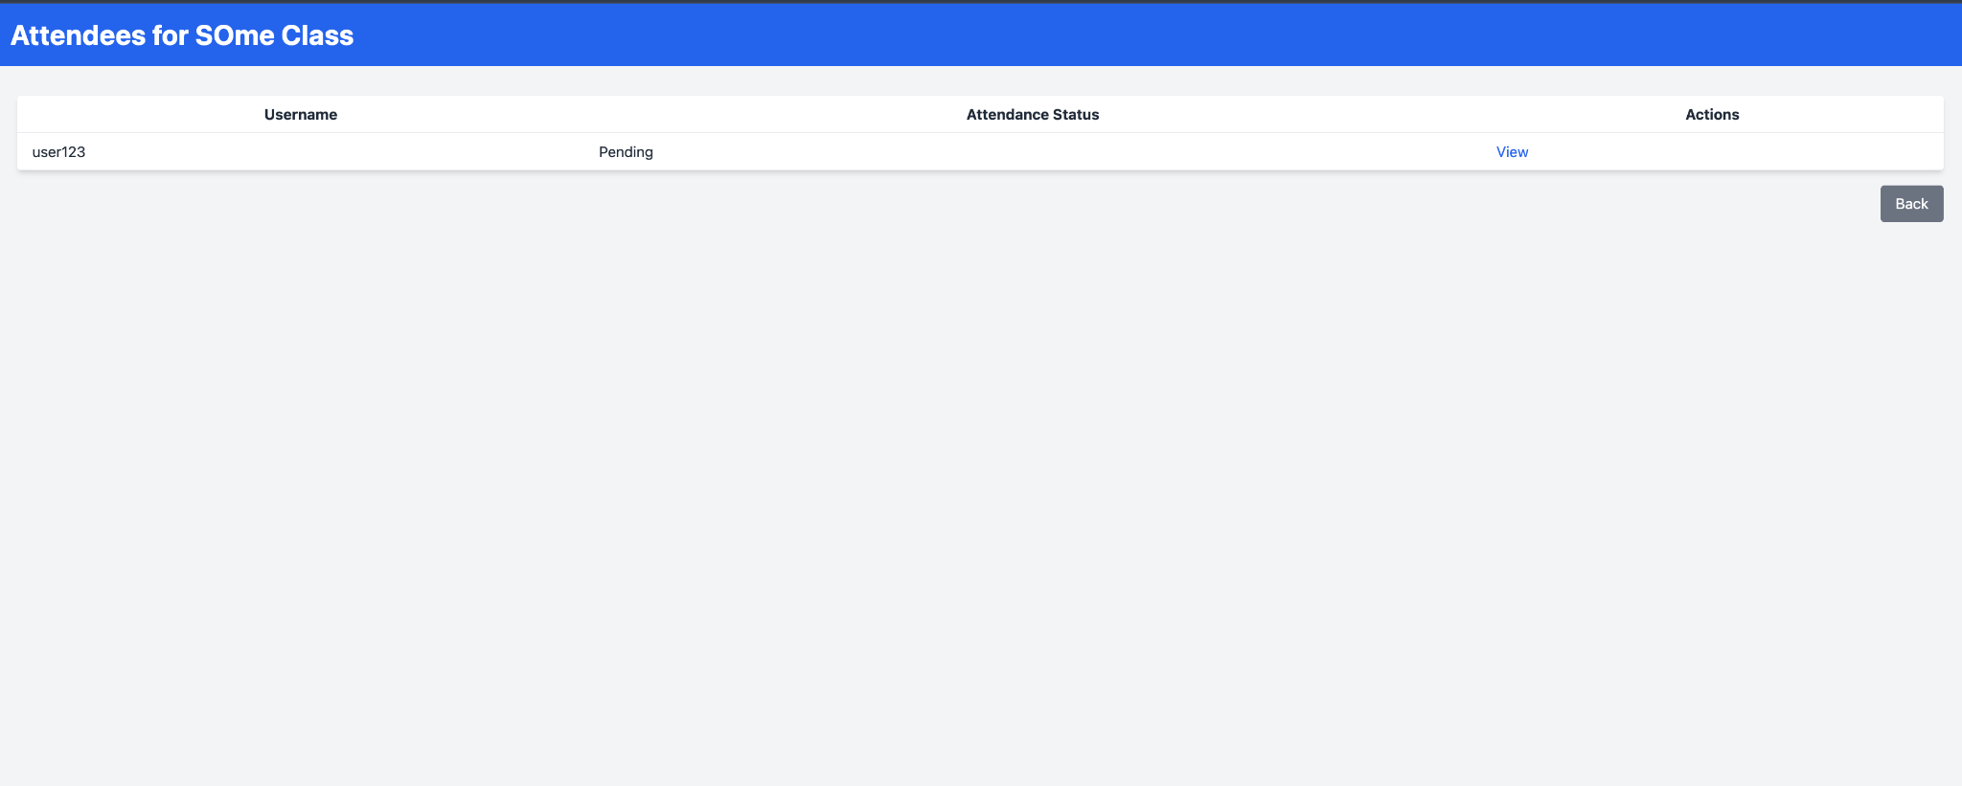
View Attendees

Slide 20
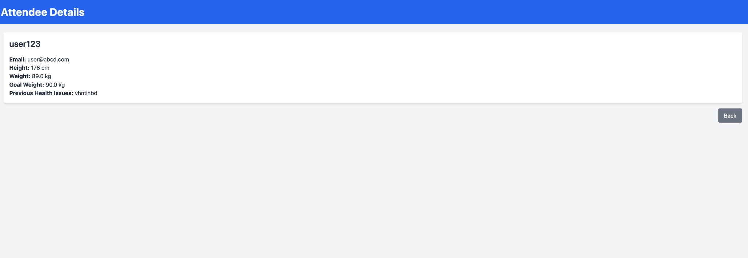
Attendee details

Slide 21
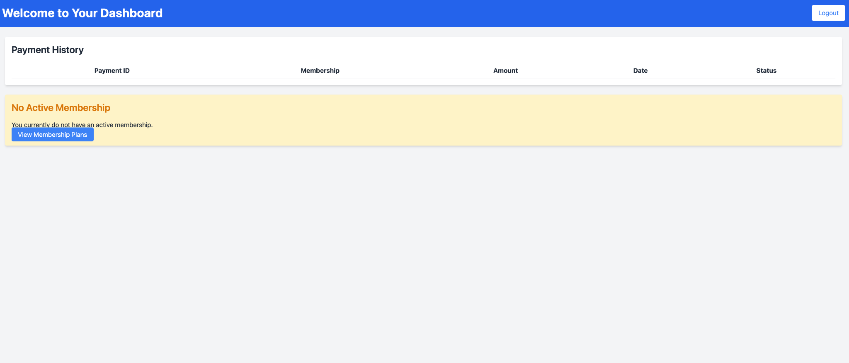
User Dashboard

Slide 22
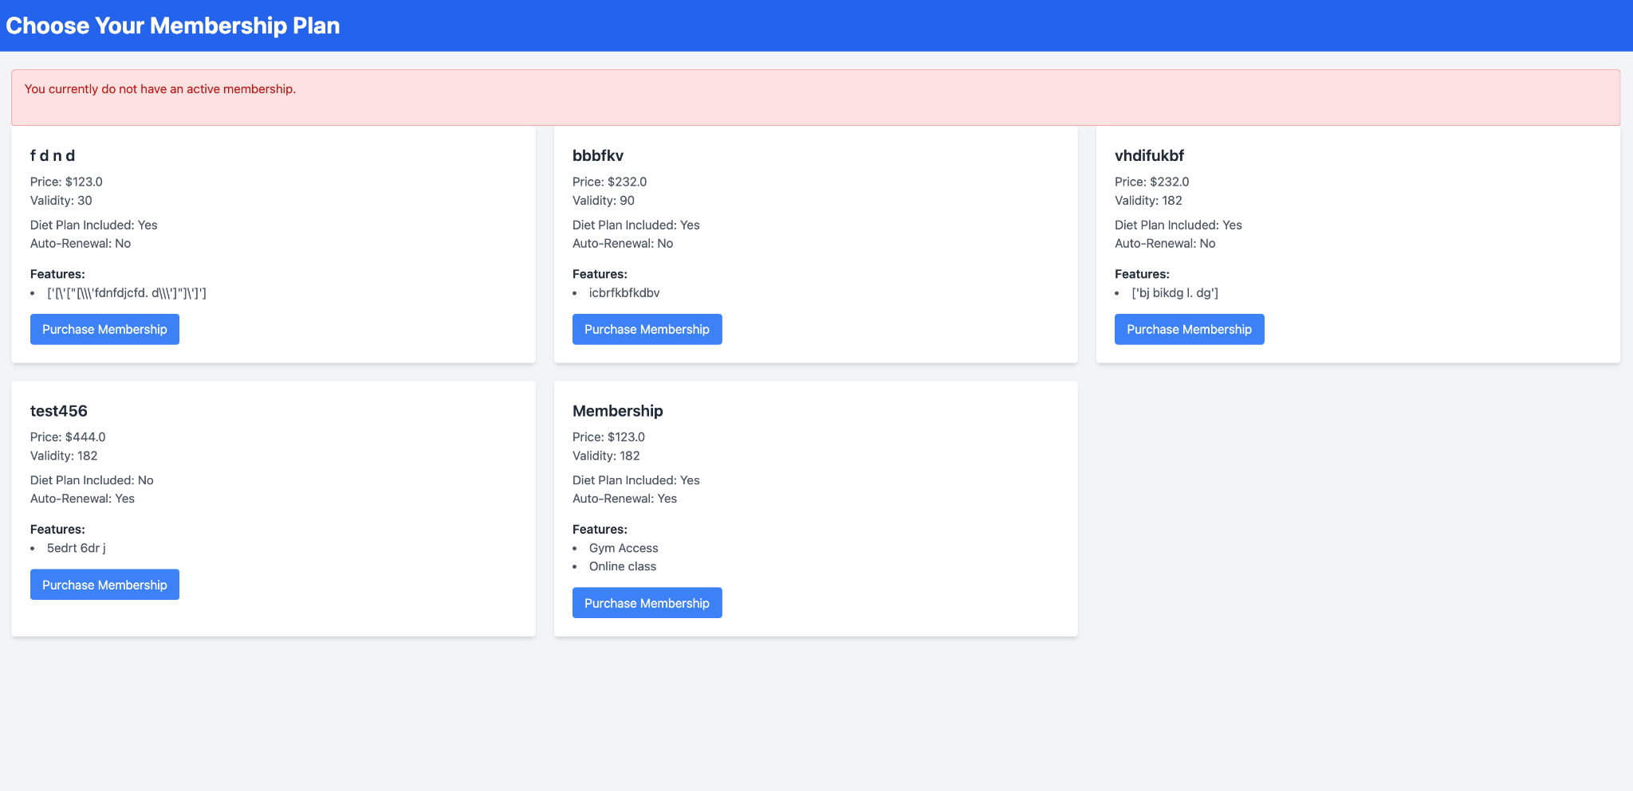
Membership Details

Slide 23
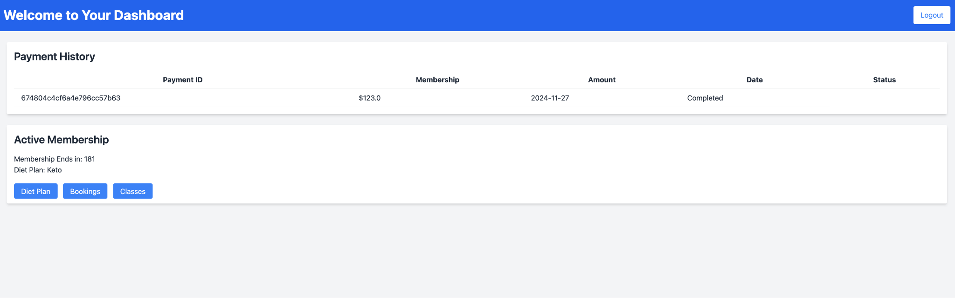
User Dashboard

Slide 24
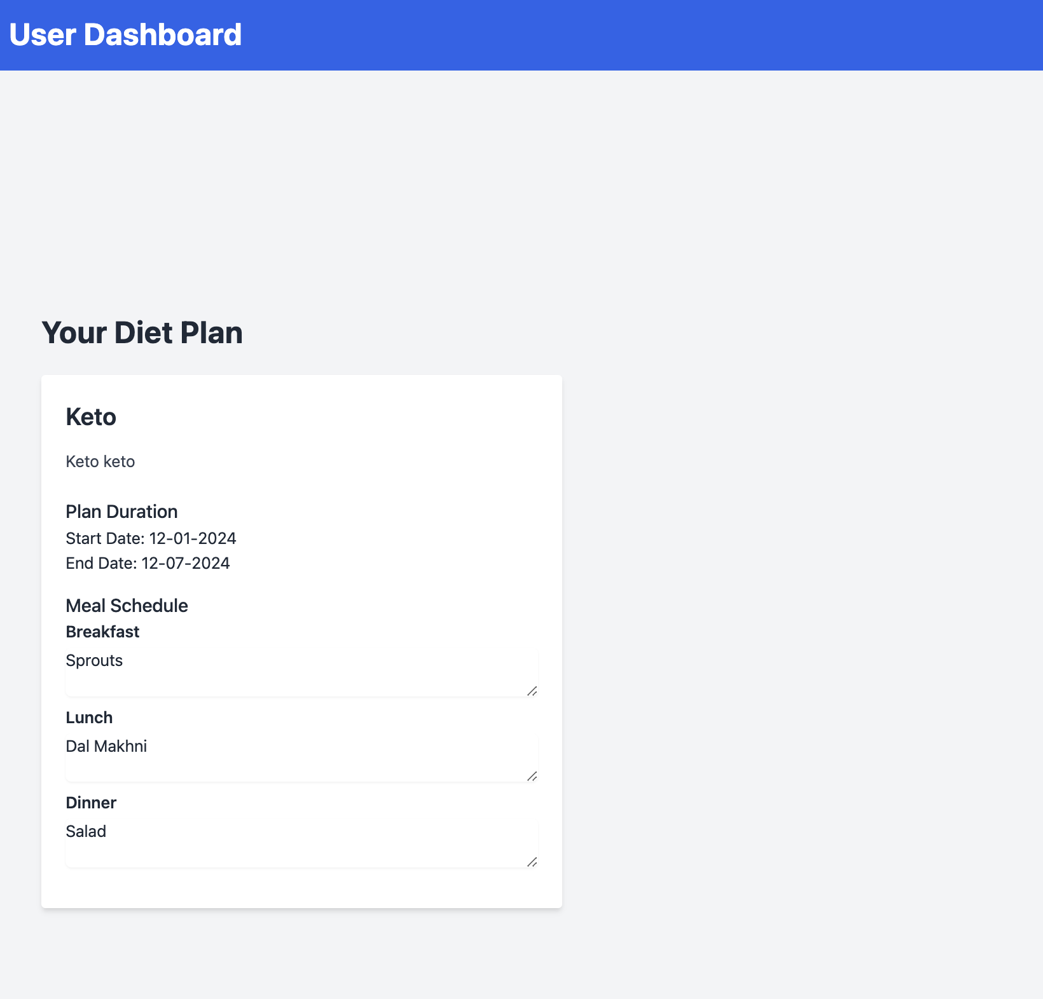
Diet Plan

Slide 25
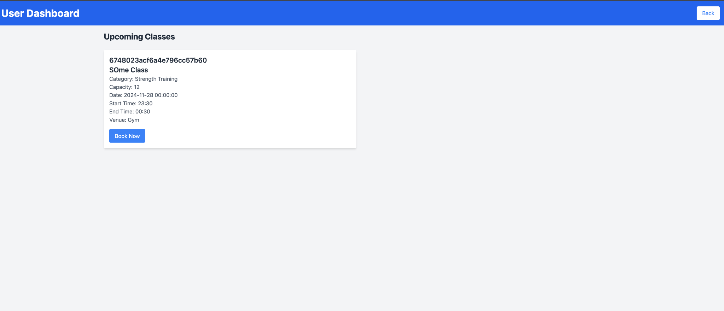
View Classes

Slide 26
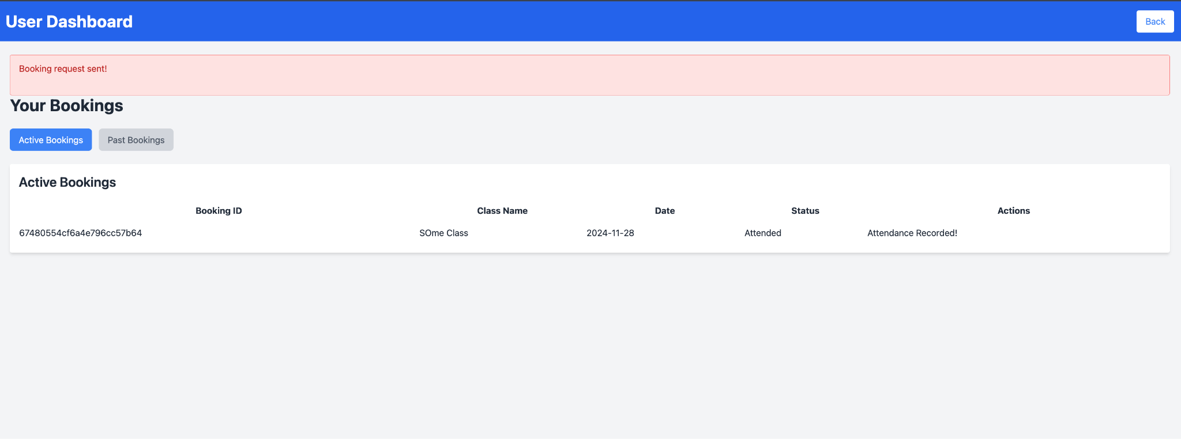
Bookings

Slide 27
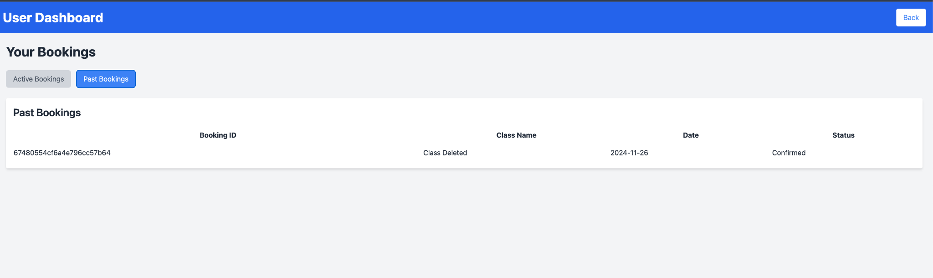
Past Bookings

Slide 28
Thank You

